Slide 1
Predicate Logic: Scope, Negation, Nesting
CS 236
Fall 2023

Slide 2
Overview
Topics
Precedence of logical operators
Scope, bound and free
deMorgan’s laws for quantified variables
Two useful rules of inference
Assuming you won’t have read before class this week
Due
Project 2 is due today
HW 10a and 10b is due Wednesday
HW 11a and 11b is due Friday
Midterm opens Tuesday, Oct 24 through Friday Oct 27
We’ll have a review on Monday, Oct 24

Slide 3
Review from last class

Slide 4
Universal Quantification
The universal quantifier (∀) allows us to make a statement about all possible elements of the predicate’s domain
∀x P(x) is the proposition that states for all values of x, P(x) is true
We can think of the statement “∀x P(x)” as a “big AND” statement
∀x P(x)= P(x₁) ∧ P(x₂) ∧ … ∧ P(x_{n})
Notes:
For all x can only be true if it is true for all x in the domain

Slide 5
Existential Quantification
The existential quantifier (∃) allows us to make a statement about all possible elements of the predicate’s domain
∃x P(x) is the proposition that states for some value x, P(x) is true
We can think of the statement “∃ x P(x)” as a “big OR” statement
∃x P(x)= P(x₁) ∨ P(x₂) ∨ … ∨ P(x_{n})
Notes:
There exists x is true if it is true for any x in the domain. It is only false if it is false for all x in the domain

Slide 6
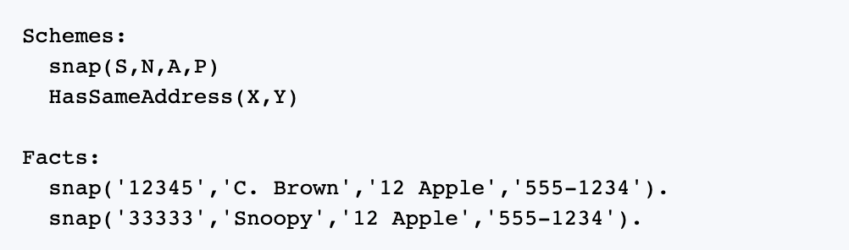
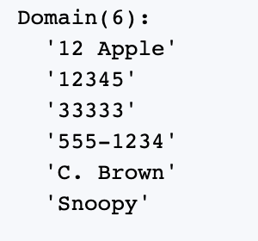
Practice
∀a,b,c,d snap(a,b,c,d) = ?
∃ a,b,c,d snap(a,b,c,d) = ?
∀d snap(‘33333’,’Snoopy’,’12 Apple’,d) = ?
∃ d snap(‘33333’,’Snoopy’,’12 Apple’,d) = ?

Slide 7
Practice
∀a,b,c,d snap(a,b,c,d) = F
∃ a,b,c,d snap(a,b,c,d) = T
∀d snap(‘33333’,’Snoopy’,’12 Apple’,d) = F
∃ d snap(‘33333’,’Snoopy’,’12 Apple’,d) = T

Slide 8
Quantifier Scope

Slide 9
Quantifier Scope
int i = 37; std::cout << "In the loop scope:\n"; for (int i = 0; i<5; i++) std::cout << "\ti = " << i << "\n"; std::cout << "Out of the loop scope: i = " << i << "\n";

Slide 10
Quantifier Scope
In the loop scope:
i = 0
i = 1
i = 2
i = 3
i = 4
Out of the loop scope: i = 37
int i = 37; std::cout << "In the loop scope:\n"; for (int i = 0; i<5; i++) std::cout << "\ti = " << i << "\n"; std::cout << "Out of the loop scope: i = " << i << "\n";

Slide 11
Quantifier Scope
In the loop scope:
i = 0
i = 1
i = 2
i = 3
i = 4
Out of the loop scope: i = 37
int i = 37; std::cout << "In the loop scope:\n"; for (int i = 0; i<5; i++) std::cout << "\ti = " << i << "\n"; std::cout << "Out of the loop scope: i = " << i << "\n";
Don’t do this – it’s bad coding style

Slide 12
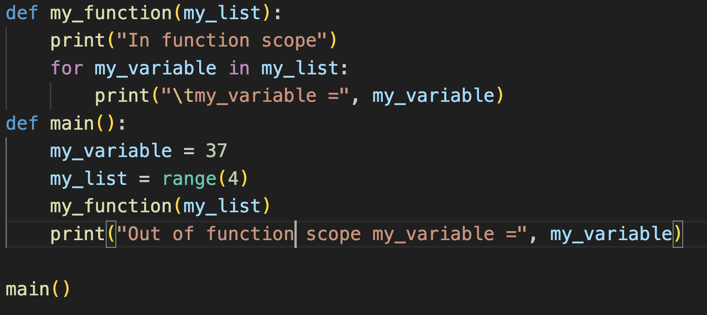
Quantifier Scope
In function scope
my_variable = 0
my_variable = 1
my_variable = 2
my_variable = 3
Out of function scope my_variable = 37

Slide 13
Quantifier Scope
A variable is said to be bound when it is used with a quantifier

Slide 14
Quantifier Scope
A variable is said to be bound when it is used with a quantifier
A variable without a quantifier is free

Slide 15
Quantifier Scope
Precedence
∀,∃ | 0
¬ | 1
∧ | 2
∨ | 3
⟶ | 4
⟷ | 5
A variable is said to be bound when it is used with a quantifier
A variable without a quantifier is free
Determine which of the following variables are bound or free:

Slide 16
Quantifier Scope
Precedence
∀,∃ | 0
¬ | 1
∧ | 2
∨ | 3
⟶ | 4
⟷ | 5
A variable is said to be bound when it is used with a quantifier
A variable without a quantifier is free
Determine which of the following variables are bound or free:
bound

Slide 17
Quantifier Scope
A variable is said to be bound when it is used with a quantifier
A variable without a quantifier is free
Determine which of the following variables are bound or free:
bound
free

Slide 18
Quantifier Scope
A variable is said to be bound when it is used with a quantifier
A variable without a quantifier is free
Determine which of the following variables are bound or free:
bound
free
from the scope of the forall loop

Slide 19
Quantifier Scope
A variable is said to be bound when it is used with a quantifier
A variable without a quantifier is free
Determine which of the following variables are bound or free:
In effect, these x’s are completely different variables that just happen to have the same name
bound
free

Slide 20
Quantifier Scope
A variable is said to be bound when it is used with a quantifier
A variable without a quantifier is free
Determine which of the following variables are bound or free:
The scope of the quantifier is the part of the logical expression to which the quantifier applies
scope of ∀x

Slide 21
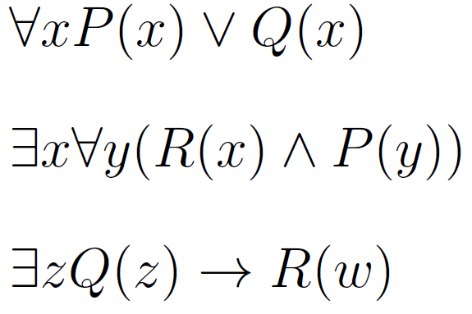
Quantifier Scope
Precedence
∀,∃ | 0
¬ | 1
∧ | 2
∨ | 3
⟶ | 4
⟷ | 5
A variable is said to be bound when it is used with a quantifier
A variable without a quantifier is free
Determine which of the following variables are bound or free:

Slide 22
Quantifier Scope
Precedence
∀,∃ | 0
¬ | 1
∧ | 2
∨ | 3
⟶ | 4
⟷ | 5
A variable is said to be bound when it is used with a quantifier
A variable without a quantifier is free
Determine which of the following variables are bound or free:
Variables x and w are free because they are not set with a quantifier

Slide 23
Quantifier Scope
Precedence
∀,∃ | 0
¬ | 1
∧ | 2
∨ | 3
⟶ | 4
⟷ | 5
A variable is said to be bound when it is used with a quantifier
A variable without a quantifier is free
Determine which of the following variables are bound or free:
These variables are all bound to a quantifier (note binding within parentheses)

Slide 24
Quantifier Scope
Precedence
∀,∃ | 0
¬ | 1
∧ | 2
∨ | 3
⟶ | 4
⟷ | 5
A variable is said to be bound when it is used with a quantifier
A variable without a quantifier is free
Determine which of the following variables are bound or free:
scope of ∀y

Slide 25
Quantifier Scope
Precedence
∀,∃ | 0
¬ | 1
∧ | 2
∨ | 3
⟶ | 4
⟷ | 5
A variable is said to be bound when it is used with a quantifier
A variable without a quantifier is free
Determine which of the following variables are bound or free:
scope of ∃x

Slide 26
What do we do if we have a free variable?

Slide 27
Evaluating Expressions with Free Variables
We don’t know whether the following expression evaluates to true or false …
… because we don’t know which x is in Q(x)
T
T
T
T
T
F
T
F

Slide 28
Evaluating Expressions with Free Variables
We don’t know whether the following expression evaluates to true or false …
… because we don’t know which x is in Q(x)
T
T
T
T
T
F
When we must evaluate an expression with free variables, we need a rule or convention to tell us what to do
T
F

Slide 29
Free Variables
What should we do with free variables?
We must set the free variables to a quantifier so that we can make a proposition
By convention we use universal quantification
By convention, we convert these using universal quantification
When we must evaluate an expression with free variables, we need a rule or convention to tell us what to do

Slide 30

Free Variables: Example
Why do we use universal quantification by convention?
Let Q(z) represents the predicate “student z passes the quiz”
Let R(w) represents the predicate “student w is rewarded and can turn in the project late”
“If there is a least one student z who passed the quiz, then student w is rewarded and can turn in the project late”

Slide 31
Free Variables: Example
Why do we use universal quantification by convention?
Let Q(z) represents the predicate “student z passes the quiz”
Let R(w) represents the predicate “student w is rewarded and can turn in the project late”
By convention, since the variable is not bound then the logical expression applies to all w

Slide 32

Free Variables: Example
Why do we use universal quantification by convention?
Let Q(z) represents the predicate “student z passes the quiz”
Let R(w) represents the predicate “student w is rewarded and can turn in the project late”
By convention, since the variable is not bound then the logical expression applies to all w
“If any student passes the quiz then every student gets rewarded by being able to turn the project in late”

Slide 33
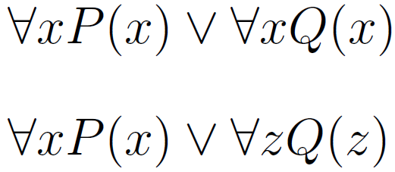
Free Variables Convention
What should we do with free variables?
We must set the free variables to a quantifier so that we can make a proposition
By convention we use universal quantification
Use universal quantification

Slide 34
Free Variables Convention
What should we do with free variables?
We must set the free variables to a quantifier so that we can make a proposition
By convention we use universal quantification
Use universal quantification
Consider renaming variable to avoid confusion

Slide 35
Quantifiers in Datalog

Slide 36


Datalog
The rules in Datalog only use universal quantifiers and the scope of the quantifier is over the entire rule
Example:

Slide 37
Datalog
The rules in Datalog only use universal quantifiers and the scope of the quantifier is over the entire rule
Example:

Slide 38
Negation with Quantifiers: DeMorgan’s Laws
DeMorgan’s Laws are logical equivalences (not inference rules)

Slide 39
DeMorgan’s Laws from Propositional Logic

Slide 40
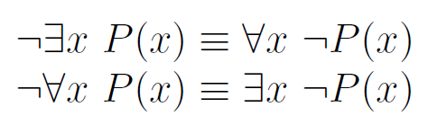
Negation with Quantifiers
De Morgan’s Laws for Quantifiers
Note: negation flips quantifier when moved inside quantifier

Slide 41
Negation with Quantifiers
De Morgan’s Laws for Quantifiers
Note: negation flips quantifier when moved inside quantifier
Intuition for why. Forall is a big AND

Slide 42
Negation with Quantifiers
De Morgan’s Laws for Quantifiers
Note: negation flips quantifier when moved inside quantifier
Intuition for why. Forall is a big AND

Slide 43
Negation with Quantifiers
De Morgan’s Laws for Quantifiers
Note: negation flips quantifier when moved inside quantifier
Intuition for why. Forall is a big AND

Slide 44
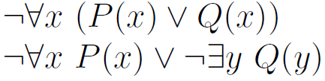
Practice
De Morgan’s Laws for Quantifiers
Using De Morgan’s laws, convert the statements:

Slide 45
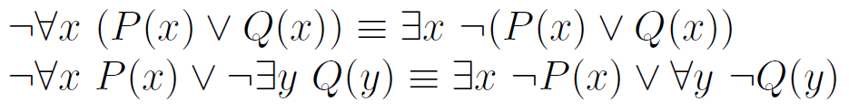
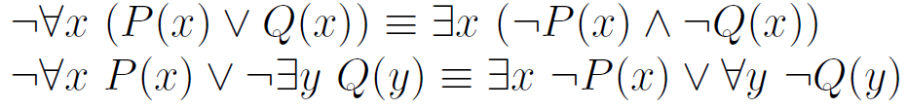
Practice
De Morgan’s Laws for Quantifiers
Using De Morgan’s laws, convert the statements:

Slide 46
Practice
De Morgan’s Laws for Quantifiers
Using De Morgan’s laws, convert the statements:

Slide 47
Practice
De Morgan’s Laws for Quantifiers
Using De Morgan’s laws, convert the statements:

Slide 48
Practice
De Morgan’s Laws for Quantifiers
Using De Morgan’s laws, convert the statements:

Slide 49
Nested Quantifiers

Slide 50
Nested Quantifiers
If we have more than one variable for a predicate, then we will need multiple quantifiers
Order of the quantified variables does not matter when all the same
See Table 1, Section 1.5.3 of the book

Slide 51
Nested Quantifiers
If we have more than one variable for a predicate, then we will need multiple quantifiers
but

Slide 52

Nested Quantifiers with Negation
Using De Morgan’s laws, convert the statement:

Slide 53

Nested Quantifiers with Negation
Using De Morgan’s laws, convert the statement:

Slide 54

Nested Quantifiers with Negation
Using De Morgan’s laws, convert the statement:

Slide 55

Nested Quantifiers with Negation
Using De Morgan’s laws, convert the statement:

Slide 56
Rules of Inference for Predicate Logic

Slide 57
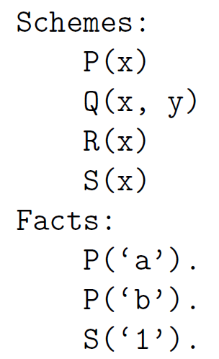
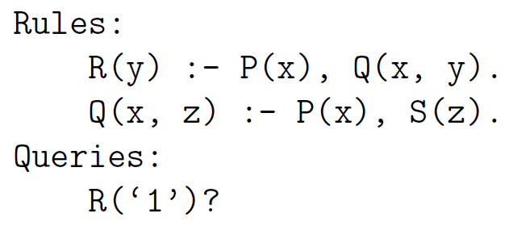
Overview
Topics
Proof by Resolution in Predicate Logic
Solve this problem

Slide 58
Overview
Topics
Proof by Resolution in Predicate Logic
Solve this problem

Slide 59
Overview
Topics
Proof by Resolution in Predicate Logic
Solve this problem
Notes:
\begin{array}{ll|l}
& \mbox{\textbf{Fact}} & \mbox{\textbf{Reason}} \\\hline
1. & P('a') & \mbox{premise} \\
2. & P('b') & \mbox{premise} \\
3. & S('1') & \mbox{premise} \\
4. & \forall x\forall y \Big[ P(x) \wedge Q(x,y) \rightarrow R(y) & \mbox{premise} \\
5. & \forall x\forall z \Big[ P(x) \wedge S(z) \rightarrow Q(x,z) & \mbox{premise}
\end{array}

Slide 60
Overview
Topics
Proof by Resolution in Predicate Logic
Prove R(‘1’)

Slide 61
Overview
Topics
Proof by Resolution in Predicate Logic
Prove R(‘1’)
We need a tool to relate quantified variables

Slide 62
Overview
Topics
Proof by Resolution in Predicate Logic
Prove R(‘1’)
We need a tool to relate quantified variables
to specific instances

Slide 63
Overview
Topics
Proof by Resolution in Predicate Logic
Prove R(‘1’)
We need a tool to relate quantified variables
to specific instances
We need a rule of inference that
always works

Slide 64
Overview
Topics
Proof by Resolution in Predicate Logic
Prove R(‘1’)
Universal instantiation
We need a tool to relate quantified variables
to specific instances
Resolution
We need a rule of inference that
always works

Slide 65
Universal Instantiation
See Table 2 in section 1.6.7
Key idea: jump back and forth between quantified variables and specific instances of them
From quantified to instance is called instantiation
From instance to quantified is called generalization

Slide 66
Universal Instantiation
HW
Photo Op
See Table 2 in section 1.6.7
Key idea: jump back and forth between quantified variables and specific instances of them
From quantified to instance is called instantiation
From instance to quantified is called generalization
Universal Instantiation
Notes:
\begin{array}{ll}
& \forall x P(x) \\\cline{2-2}
\therefore & P(c)
\end{array}

Slide 67
Using Universal Instantiation
Prove Q(‘a’,’1’)
Notes:
\begin{array}{ll|l}
& \mbox{\textbf{Fact}} & \mbox{\textbf{Reason}} \\\hline
1. & P('a') & \mbox{premise} \\
2. & P('b') & \mbox{premise} \\
3. & S('1') & \mbox{premise} \\
4. & \forall x\forall y \Big[ \neg P(x) \vee \neg Q(x,y) \vee R(y) & \mbox{premise} \\
5. & \forall x\forall z \Big[ \neg P(x) \vee \neg S(z) \vee Q(x,z) & \mbox{premise} \\
6. & \forall z \Big[ \neg P('a') \vee \neg S(z) \vee Q('a',z) \Big]& \mbox{universal instantiation on 5: $x \leftarrow 'a'$} \\
7. & \neg P('a') \vee \neg S('1') \vee Q('a','1') & \mbox{universal instantiation on 6: $z \leftarrow '1'$} \\
8. & \neg S('1') \vee Q('a','1') & \mbox{resolution on 1 and 7} \\
9. & Q('a','1') & \mbox{resolution on 3 and 8}
\end{array}

Slide 68
Using Universal Instantiation
Prove Q(‘a’,’1’)

Slide 69
Using Universal Instantiation
Prove Q(‘a’,’1’)

Slide 70
Using Universal Instantiation
Prove Q(‘a’,’1’)
Line 7 is just a compound proposition

Slide 71
Using Universal Instantiation
Prove Q(‘a’,’1’)
Line 7 is just a compound proposition
so we can use resolution

Slide 72
Using Universal Instantiation
Prove Q(‘a’,’1’)
Line 7 is just a compound proposition
so we can use resolution

Slide 73
Using Universal Instantiation
Prove Q(‘a’,’1’)
Line 7 is just a compound proposition
so we can use resolution

